Slide 1


PLEDGE TO PROGRESS Sustainability Hackathon
Sponsored By
Your Team Name : Team Uttam-Bhumi (The Best Land)
Your team bio : Technology enthusiast with special interest in IoT application for Smart metering, Smart home and energy efficiency
Date : 21 May 2023

Slide 2
Scope taken for Prototype
NET ZERO building with
Connected Air conditioning devices which help reduce energy consumption without compromising on comfort.
Smart meter which measure energy consumption from grid and solar.
Data is collected from these devices using Azure IoT Central to improve energy efficiency and increase use of clean energy.
Used that data to produce sustainability dashboards using Microsoft sustainability manager.
Rationale for taking this scope
In the last few years, several buildings in India have become net-zero energy buildings by offsetting their total annual energy requirement with renewable energy and by increasing their energy efficiency.
The Indian federal government currently has its Model Building Bye-Laws, Energy Conservation Building Code which promotes increased usage of clean energy in building design but broader norms and regulations on this are still lacking.
The Indian Green Building Council (IGBC) started voluntary ratings of net-zero buildings in 2018, where energy-efficient building design and climate-responsive designs were also given weightage, besides the use of renewables.

Slide 3
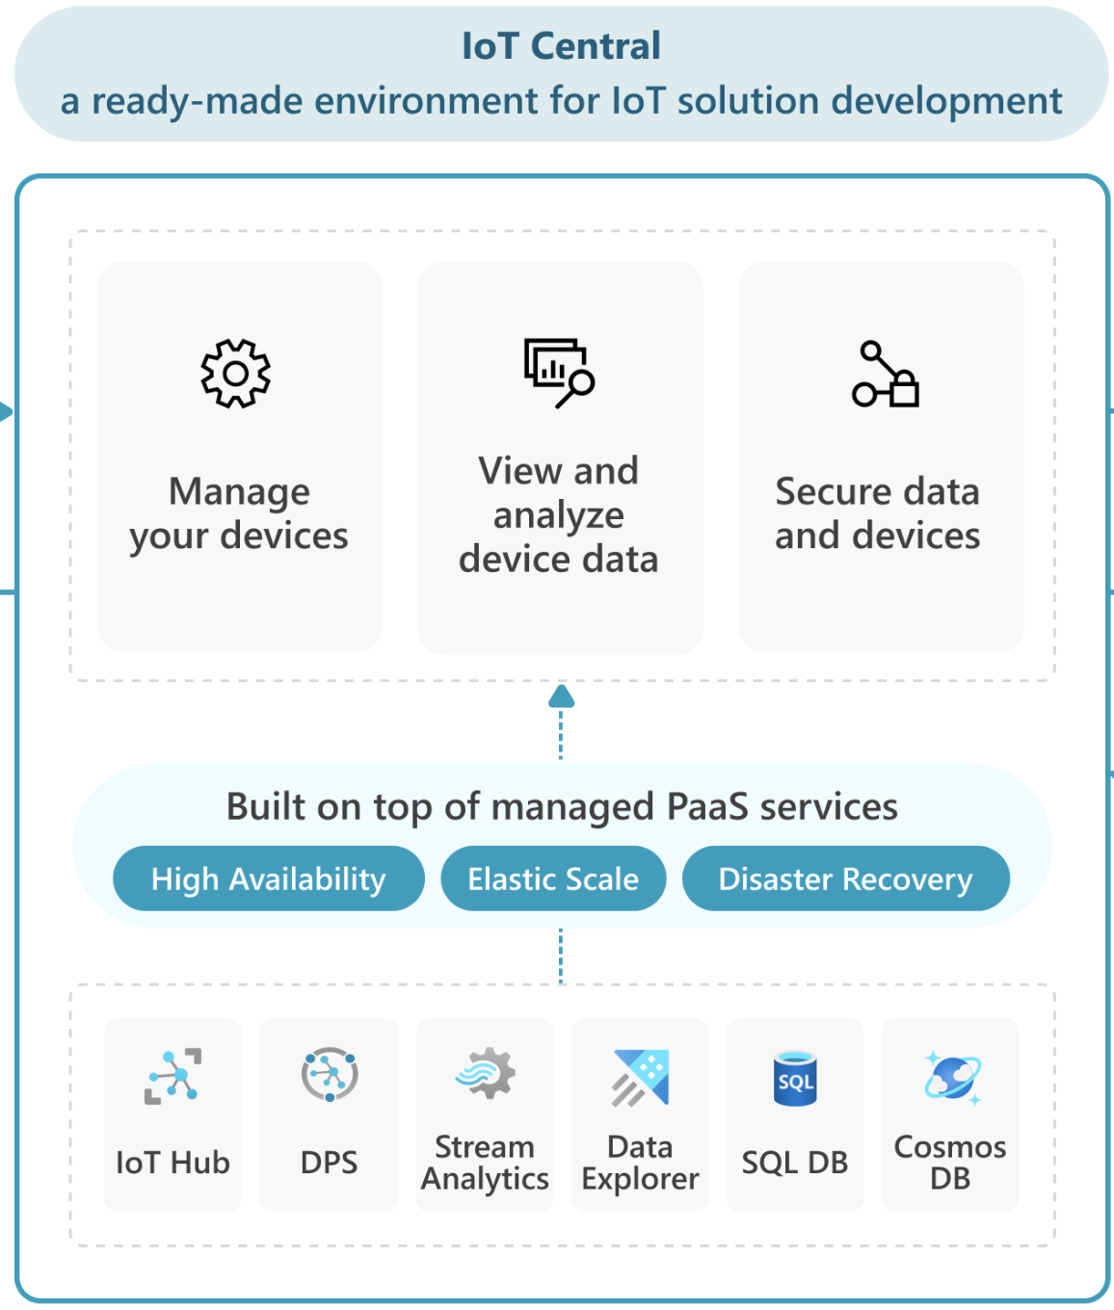
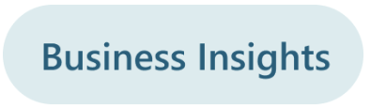
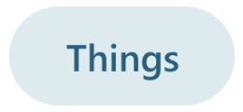
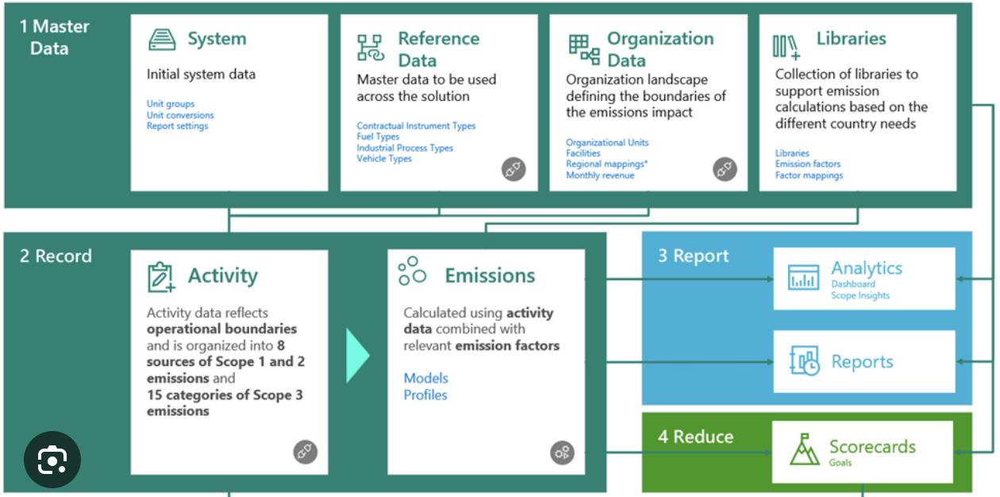
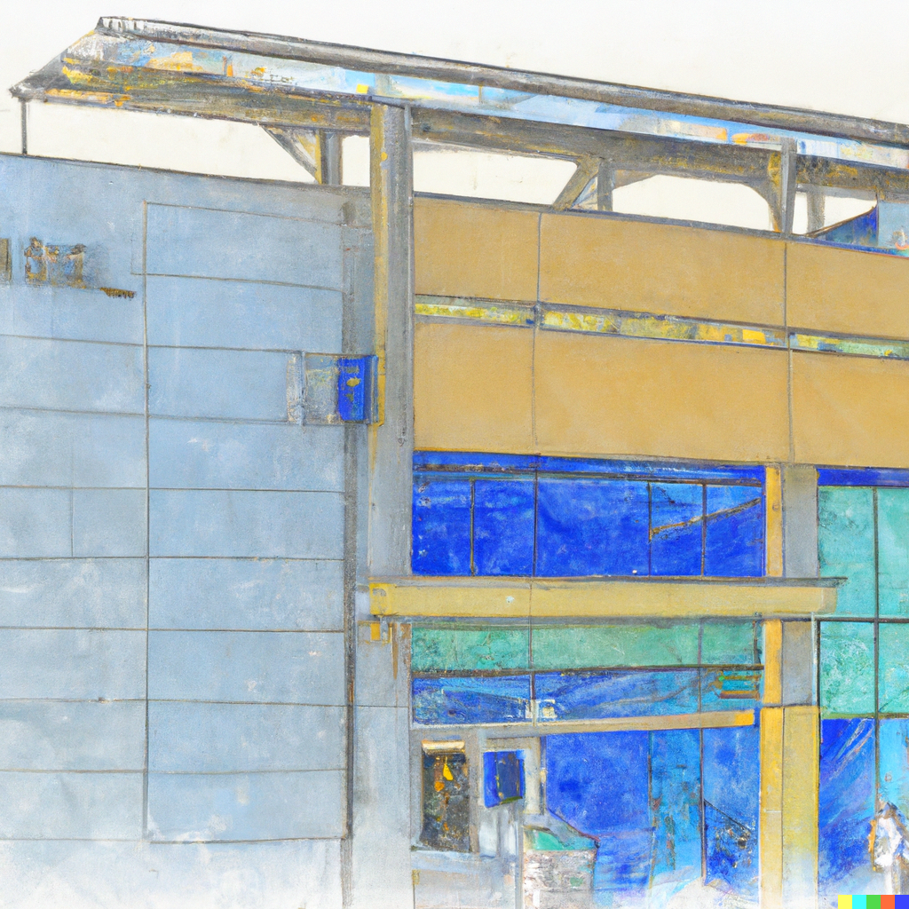
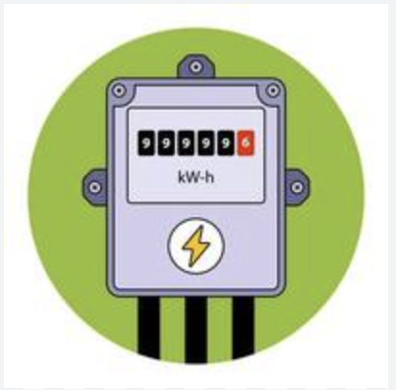
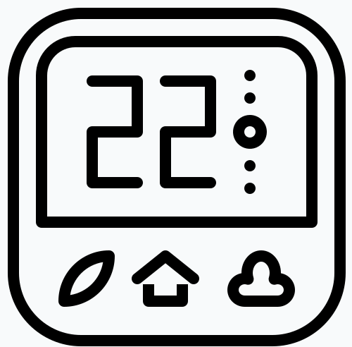
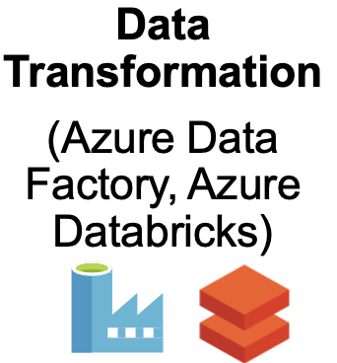
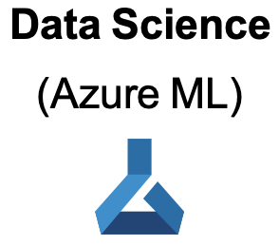
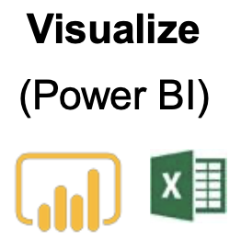
Architecture for Prototype
Connect
Export Data
Run Jobs
Trigger
Query

Slide 4
Prototype implementation so far
Prototype implementation so far
IoT Central
Created simulated devices of connected air-conditioner and smart meter
Collected data from air-conditioner (temperature, set-point, fan mode etc.) and smart meter ( kWh, Voltage, current)
Created dashboard and configuration pages for both the devices
Create export to CSV for kWh so that it can be consumed by Microsoft sustainability manager. However it cannot be used as it contain random data so it is just indicative
Microsoft sustainability manager
Setup the organization & reference data
Created excel file to import the dummy data representing energy consumption from grid and solar of NET ZERO building
Define factor library calculation model and calculation profile
Generate dashboard to view results

Slide 5
Beyond prototype
Architecture selected is scalable and extendable
IoT Central
IoT central is capable to ingesting data from device in thousands of building.
Can easily integrate the other devices like HVAC, Smart Lighting etc.
Simulators can be replaced with actual devices
Can be integrated with Azure ML for better scheduling of air-conditioner and other energy loads
Powerful visualization can be created using Power BI
Microsoft Sustainability Manager
It can be used for large number of building.
It can be easily used in incorporate other source of emission.
Calculation models can further be customized based on country regulation
More business automation & visualization can be created using power apps and power BI

Slide 6
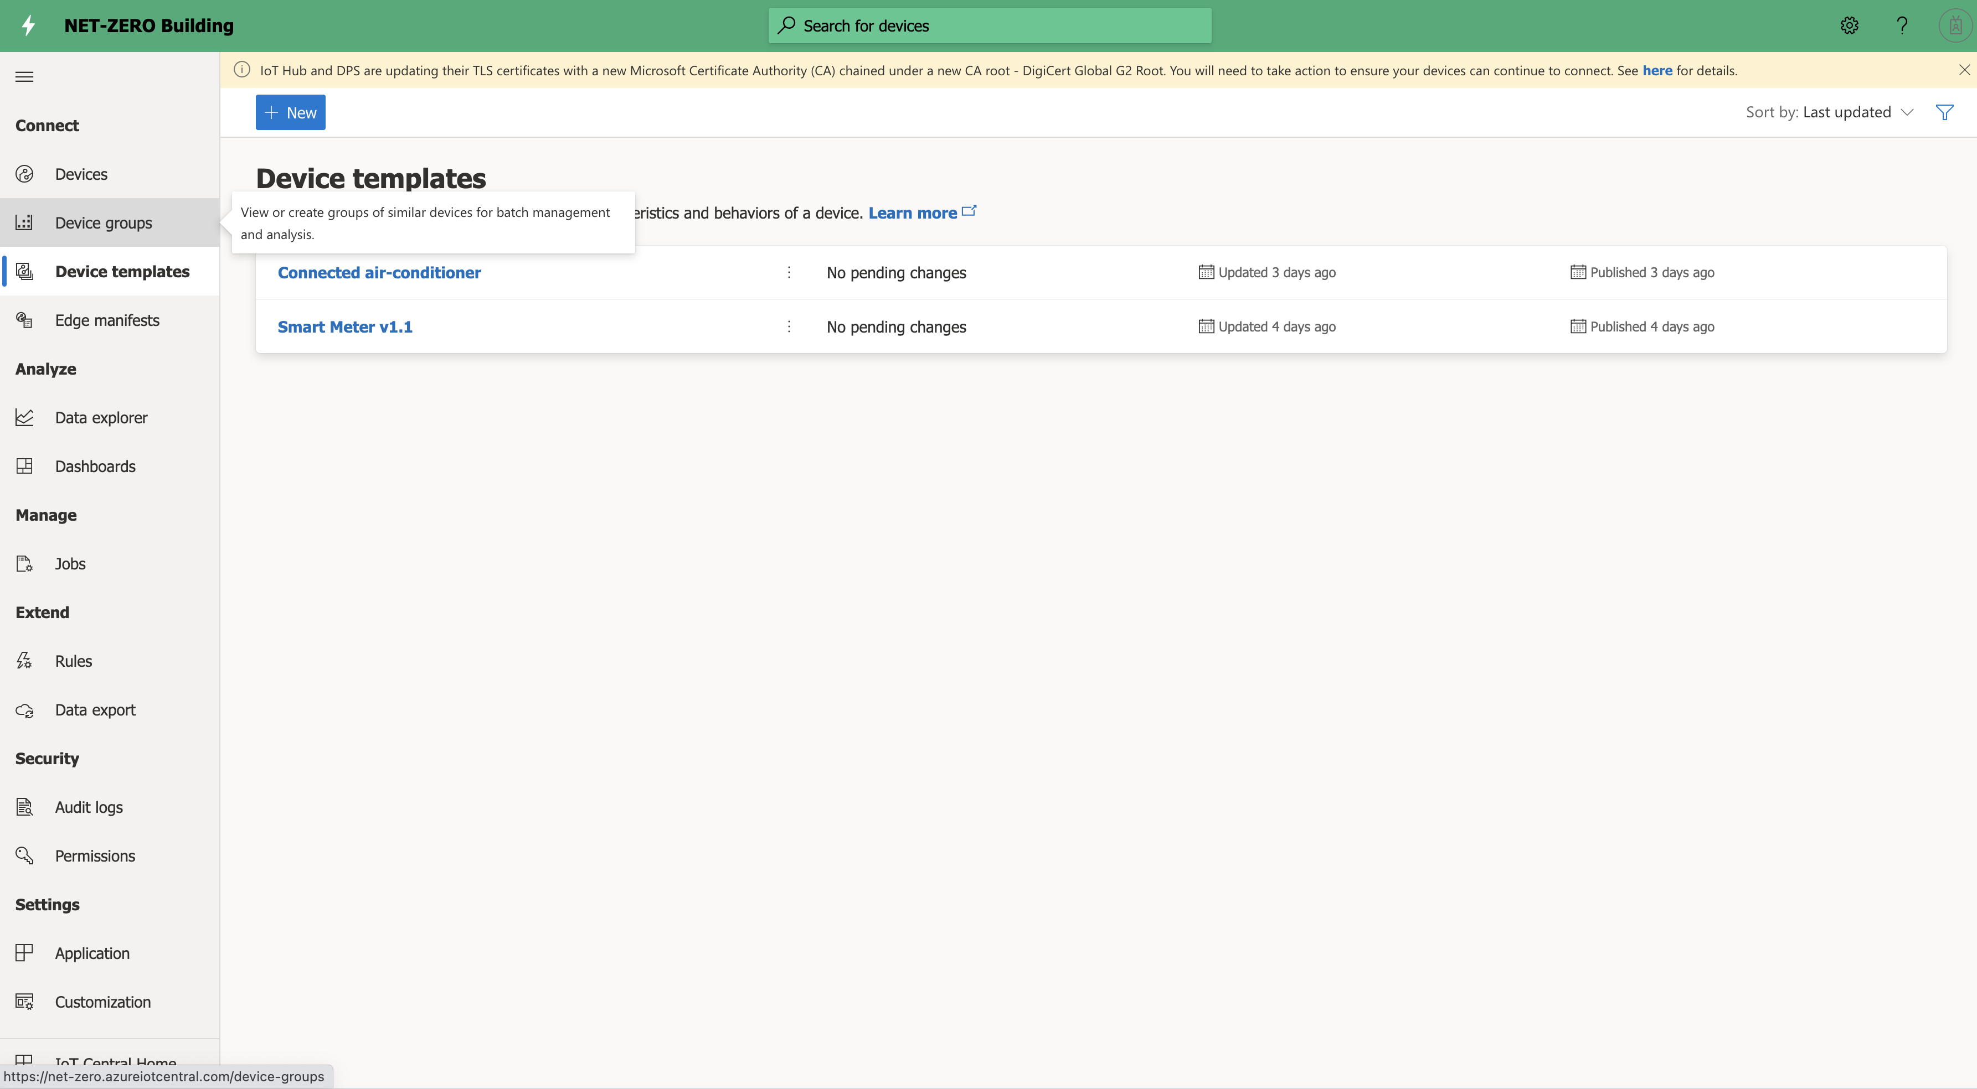
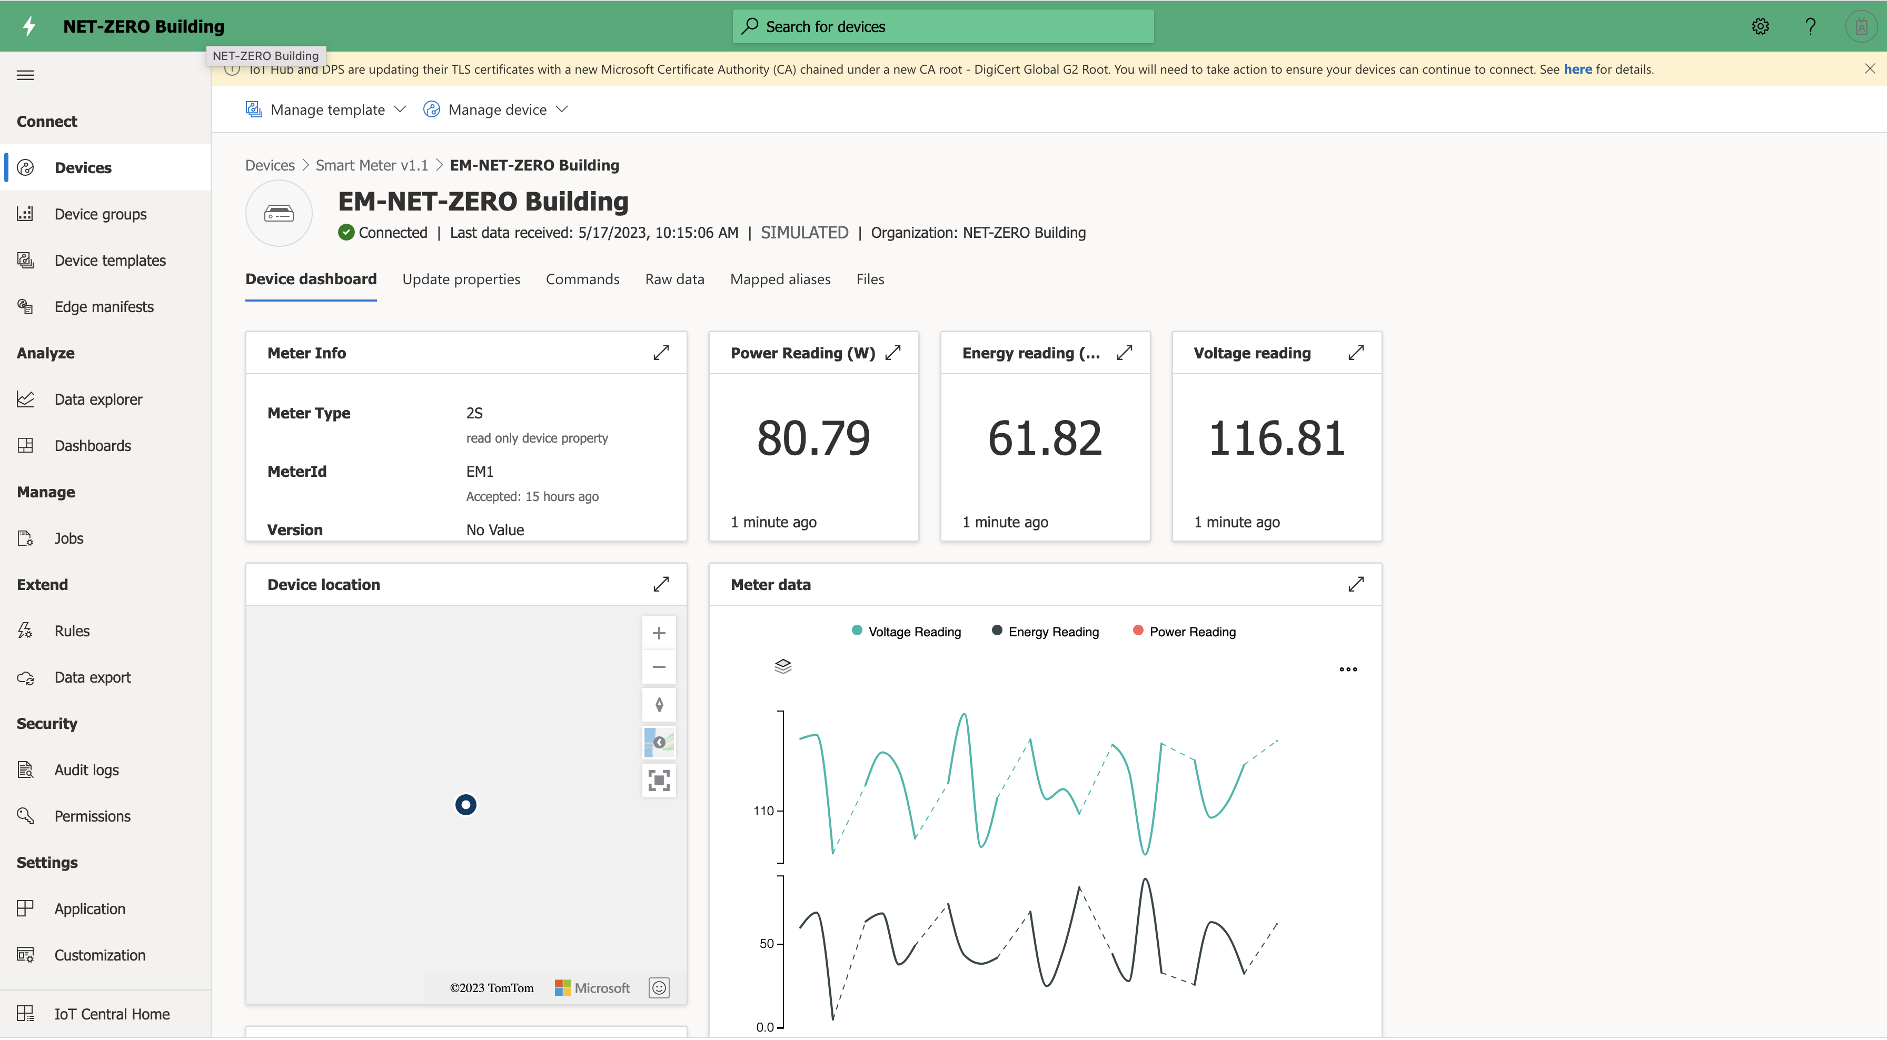
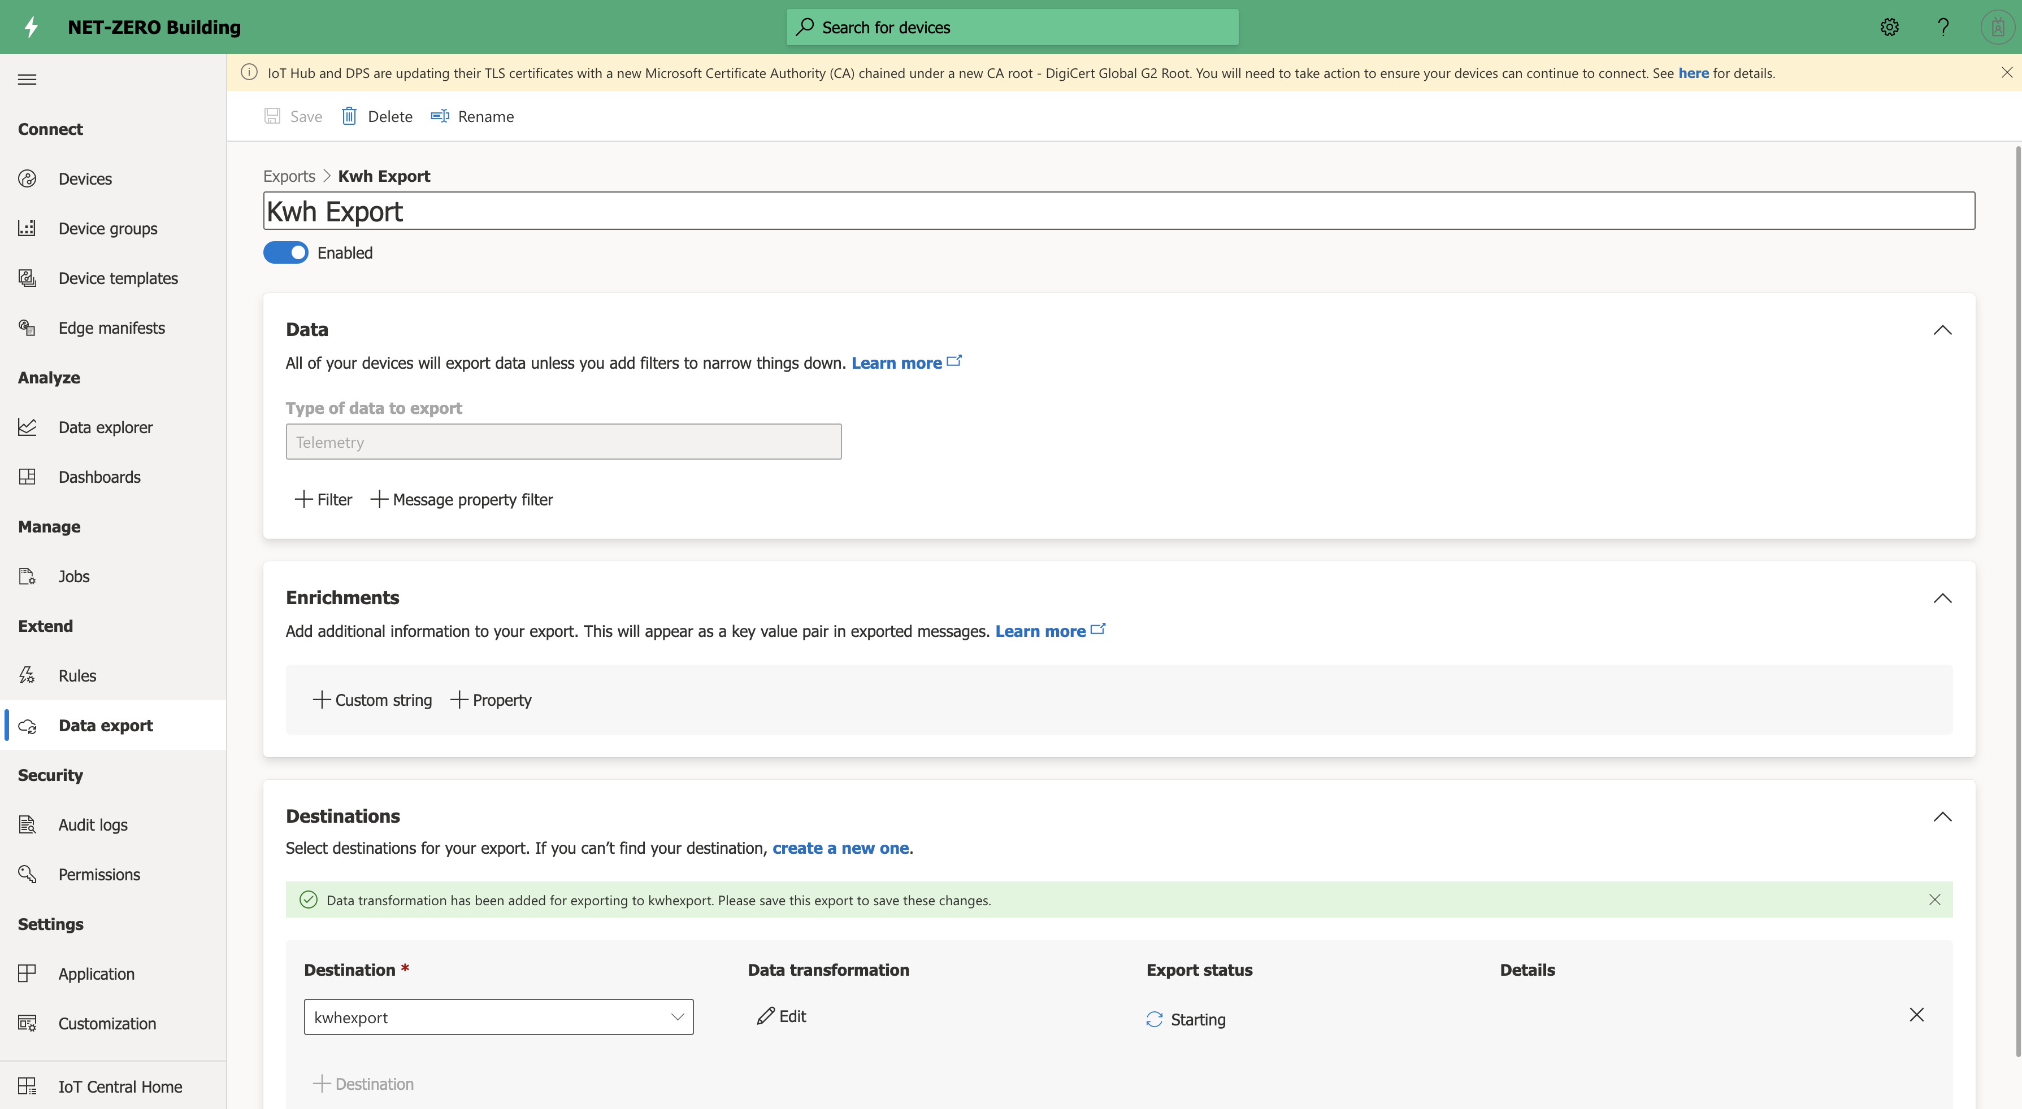
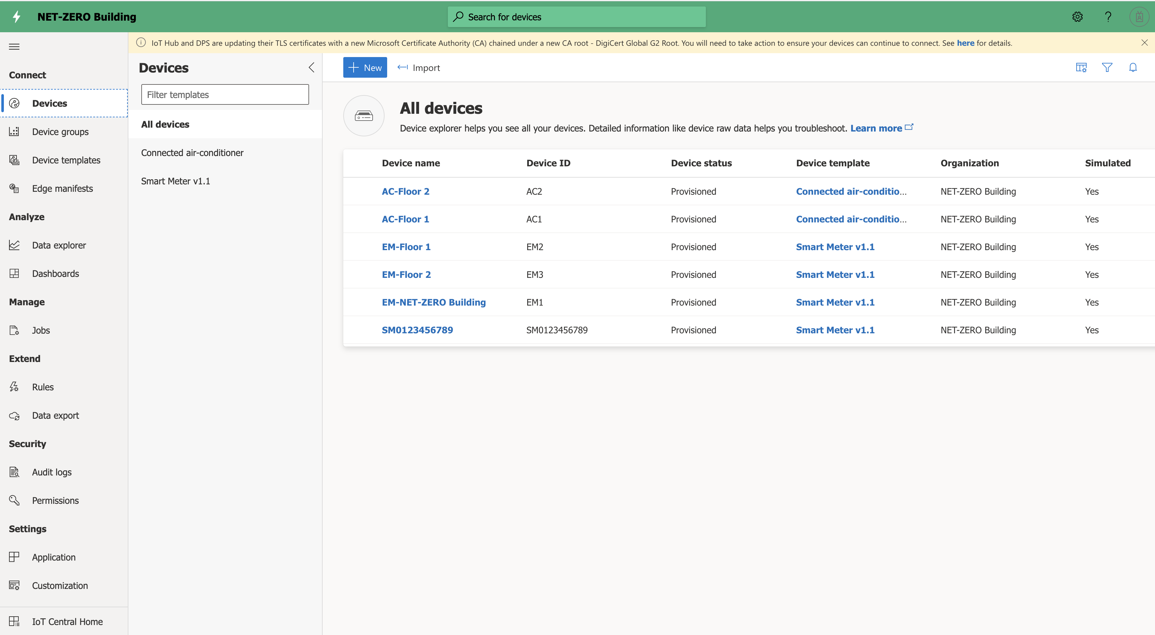
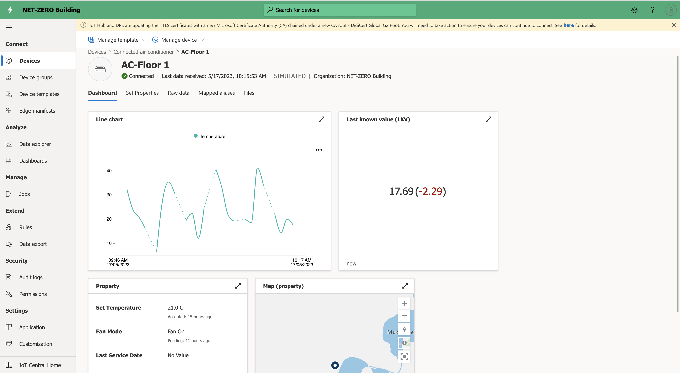
Prototype Implementation - IoT Central
Define
Visualize
Export

Slide 7
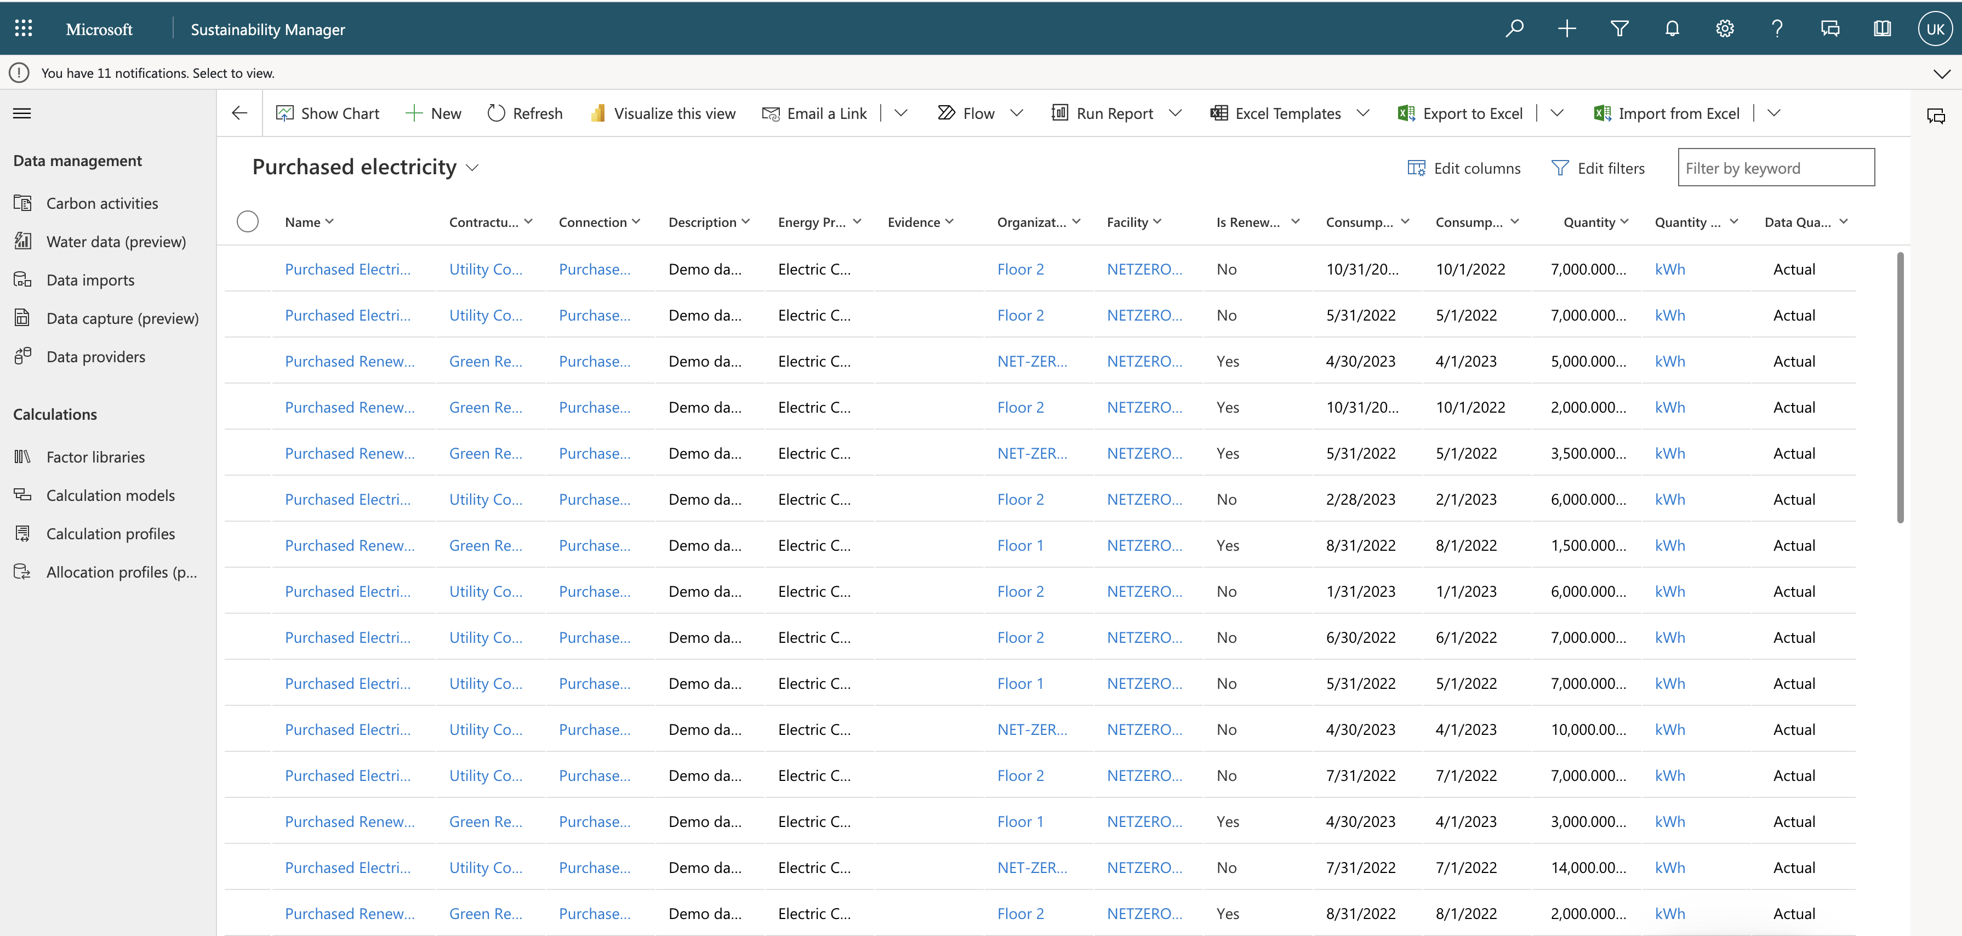
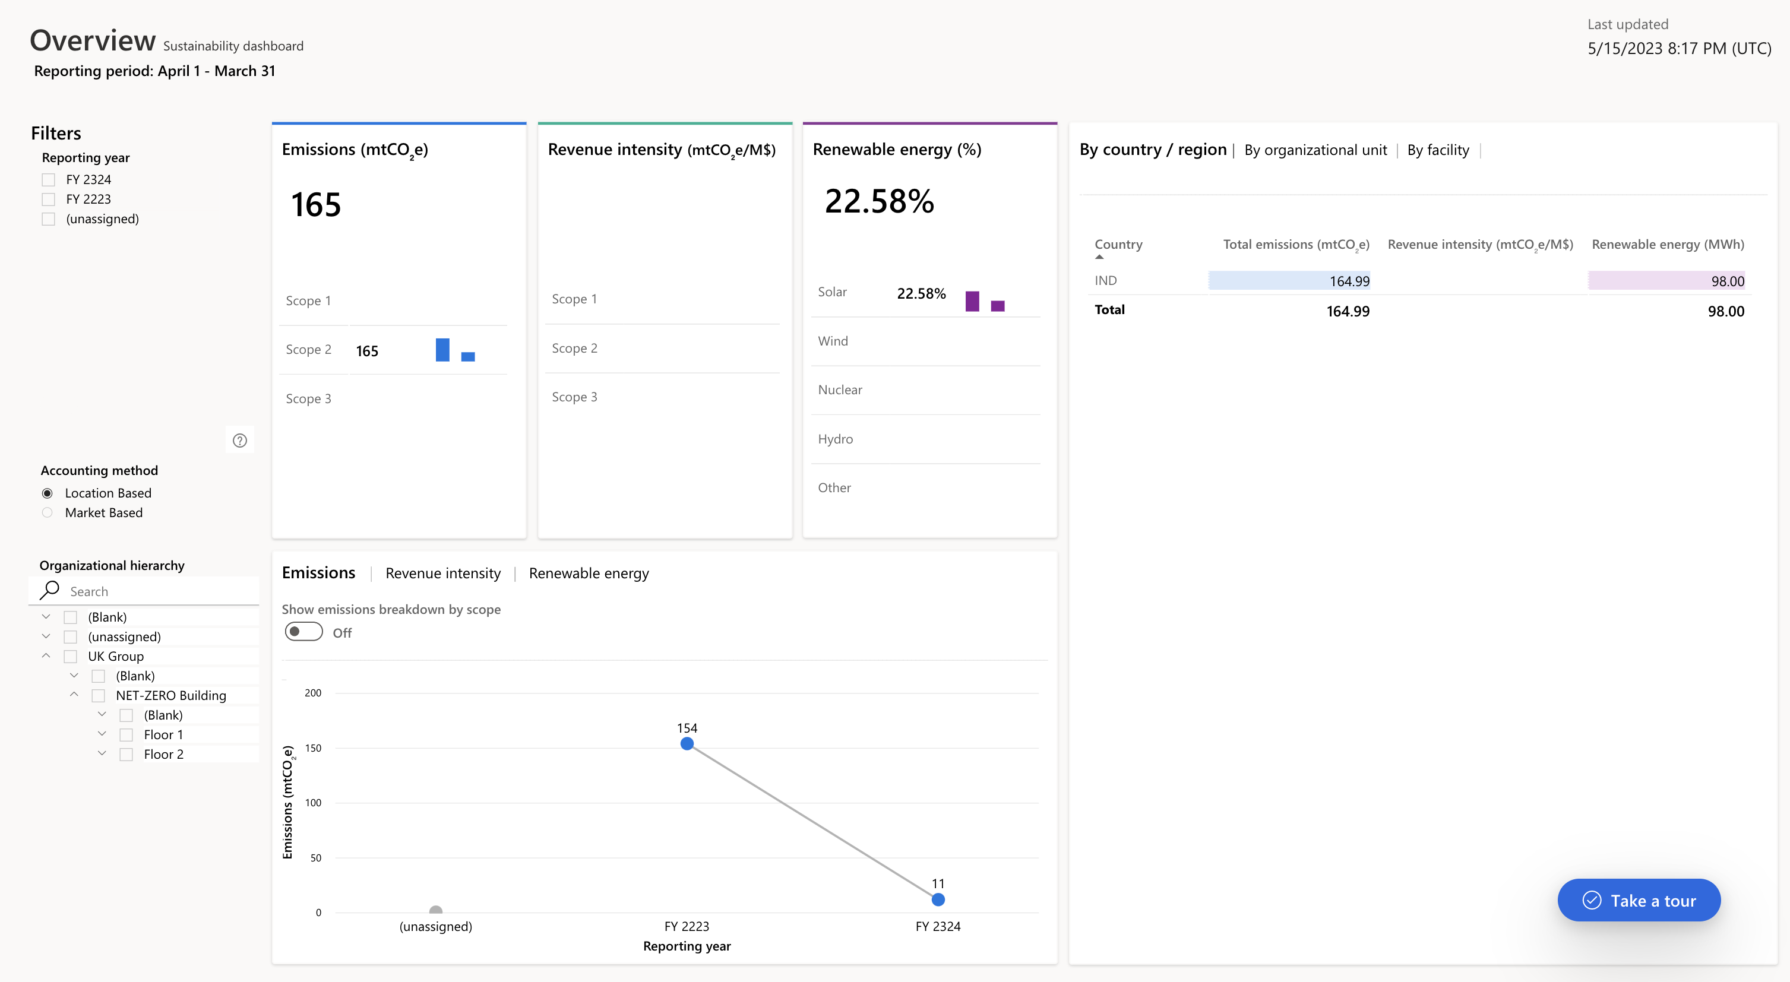
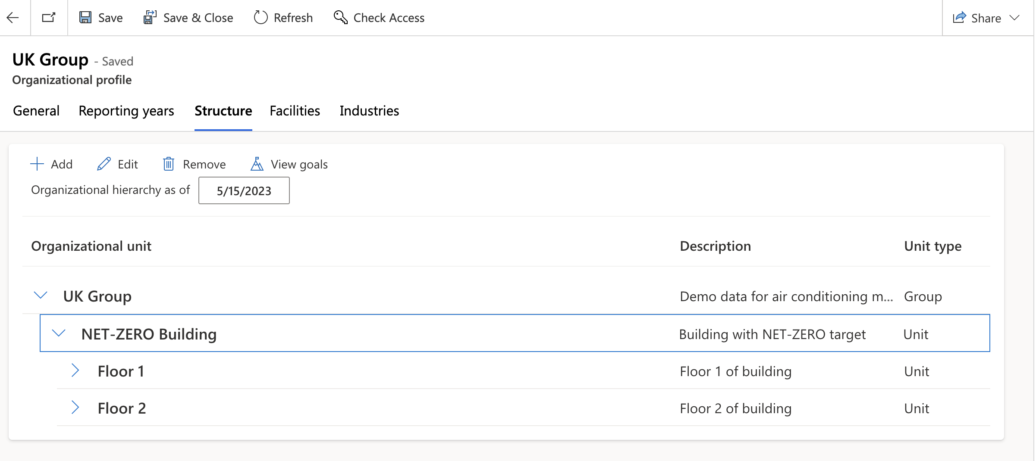
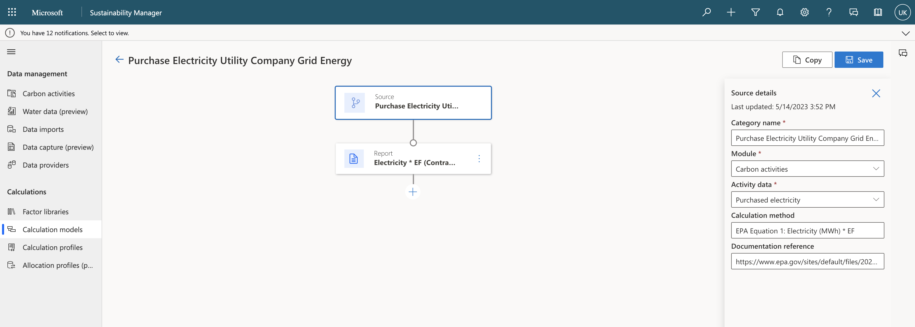
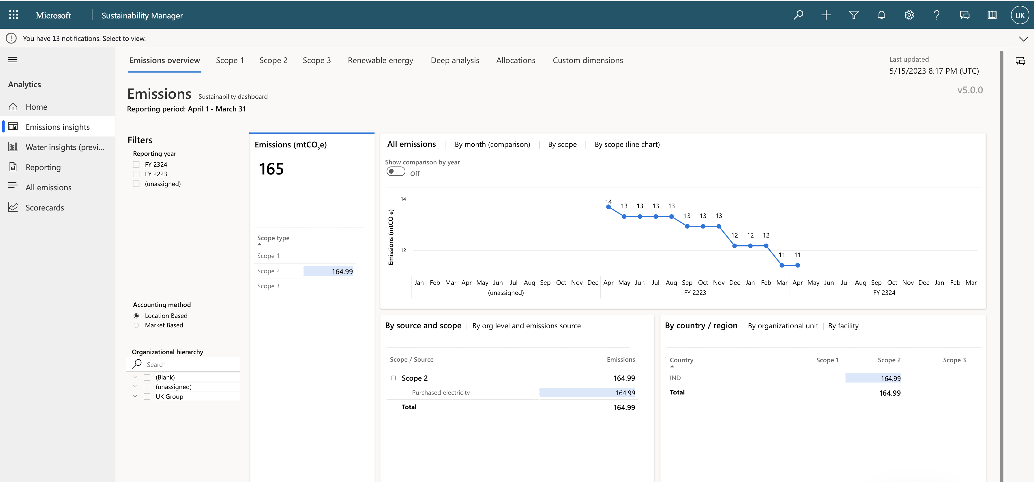
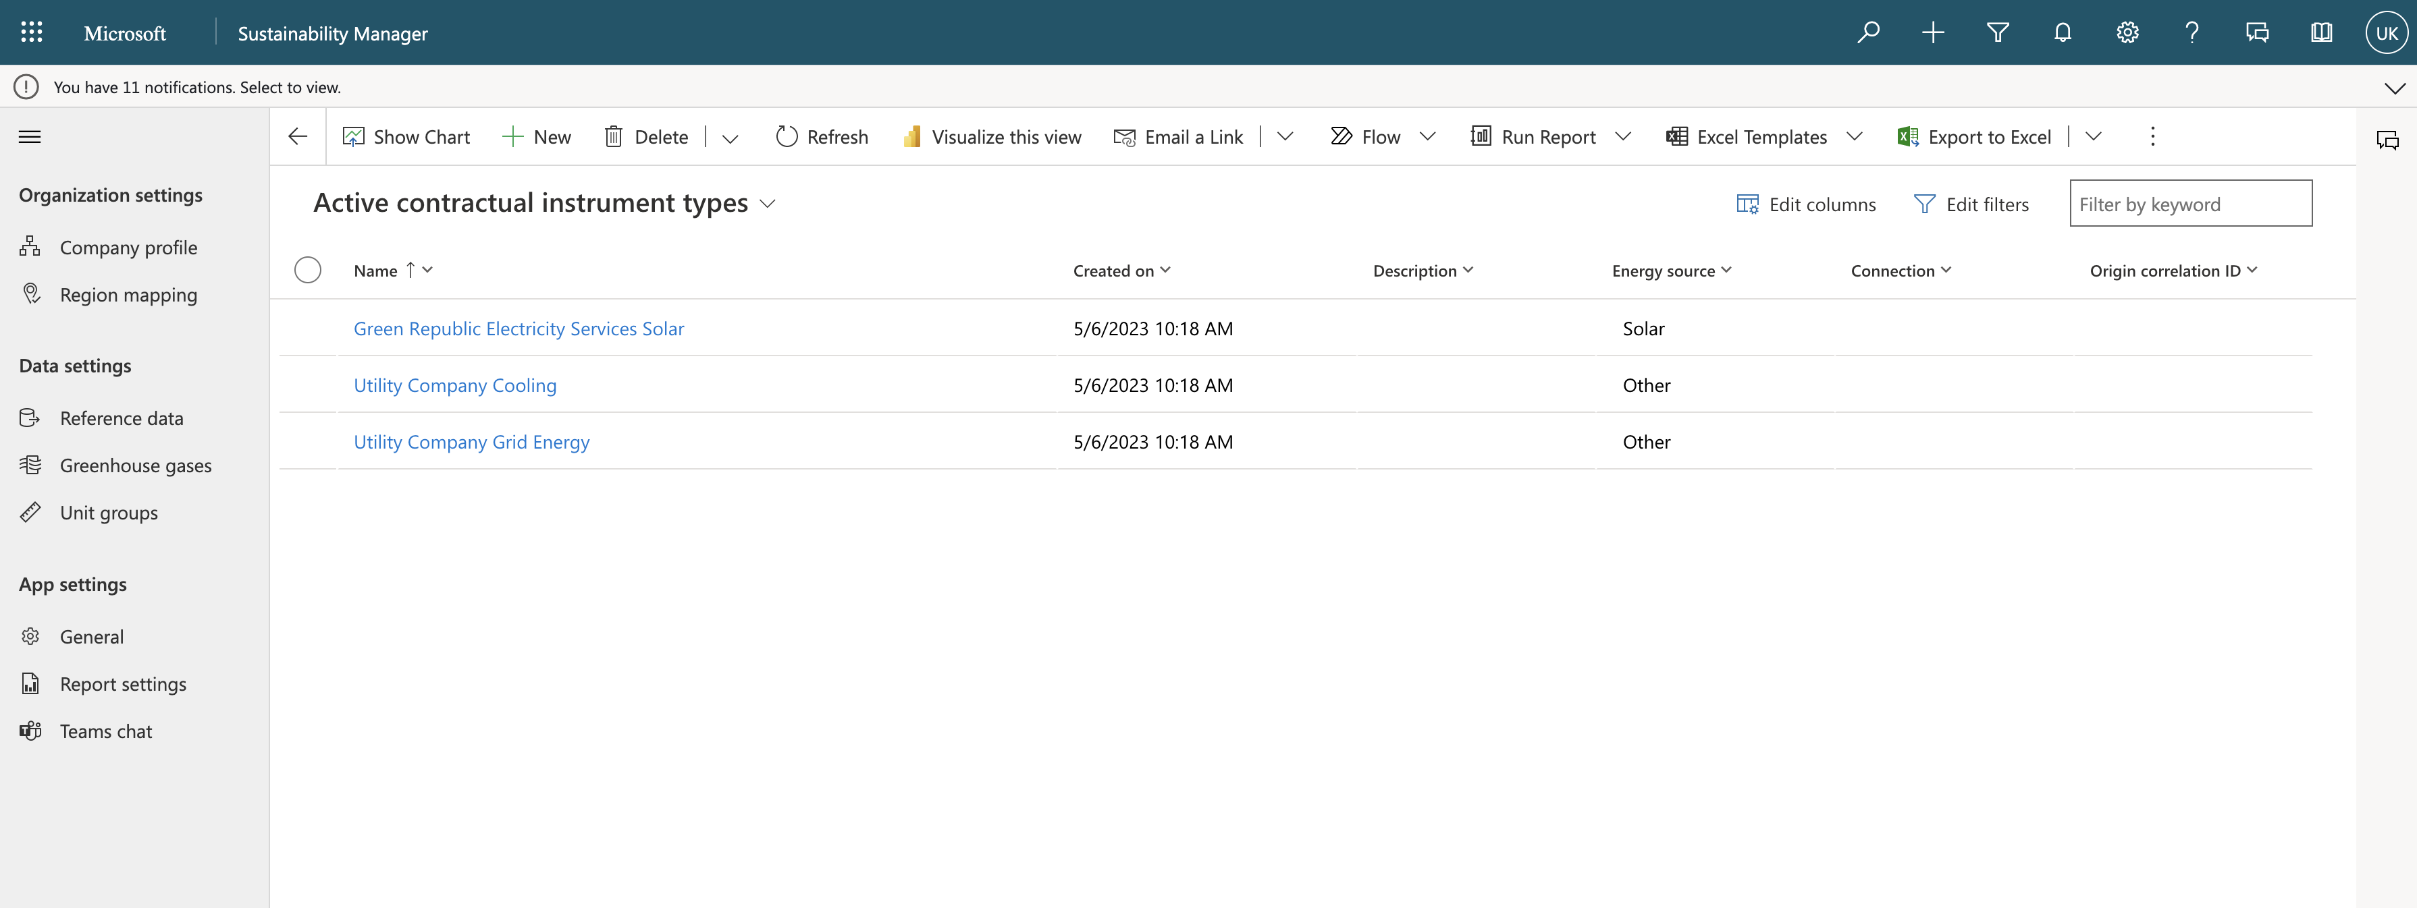
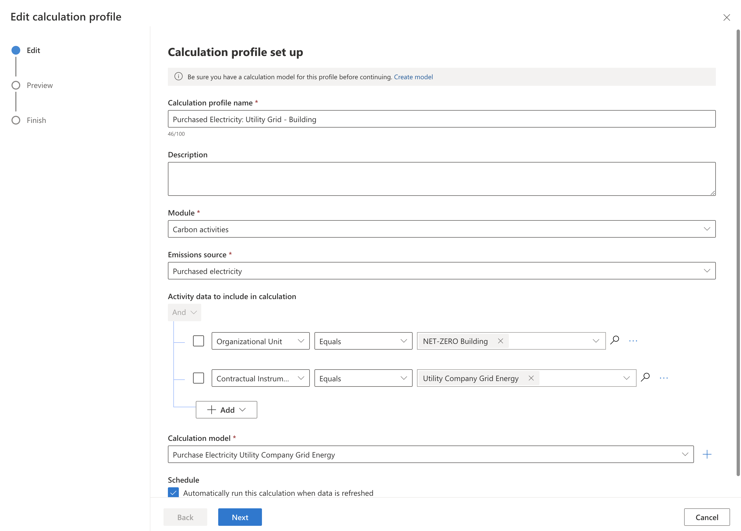
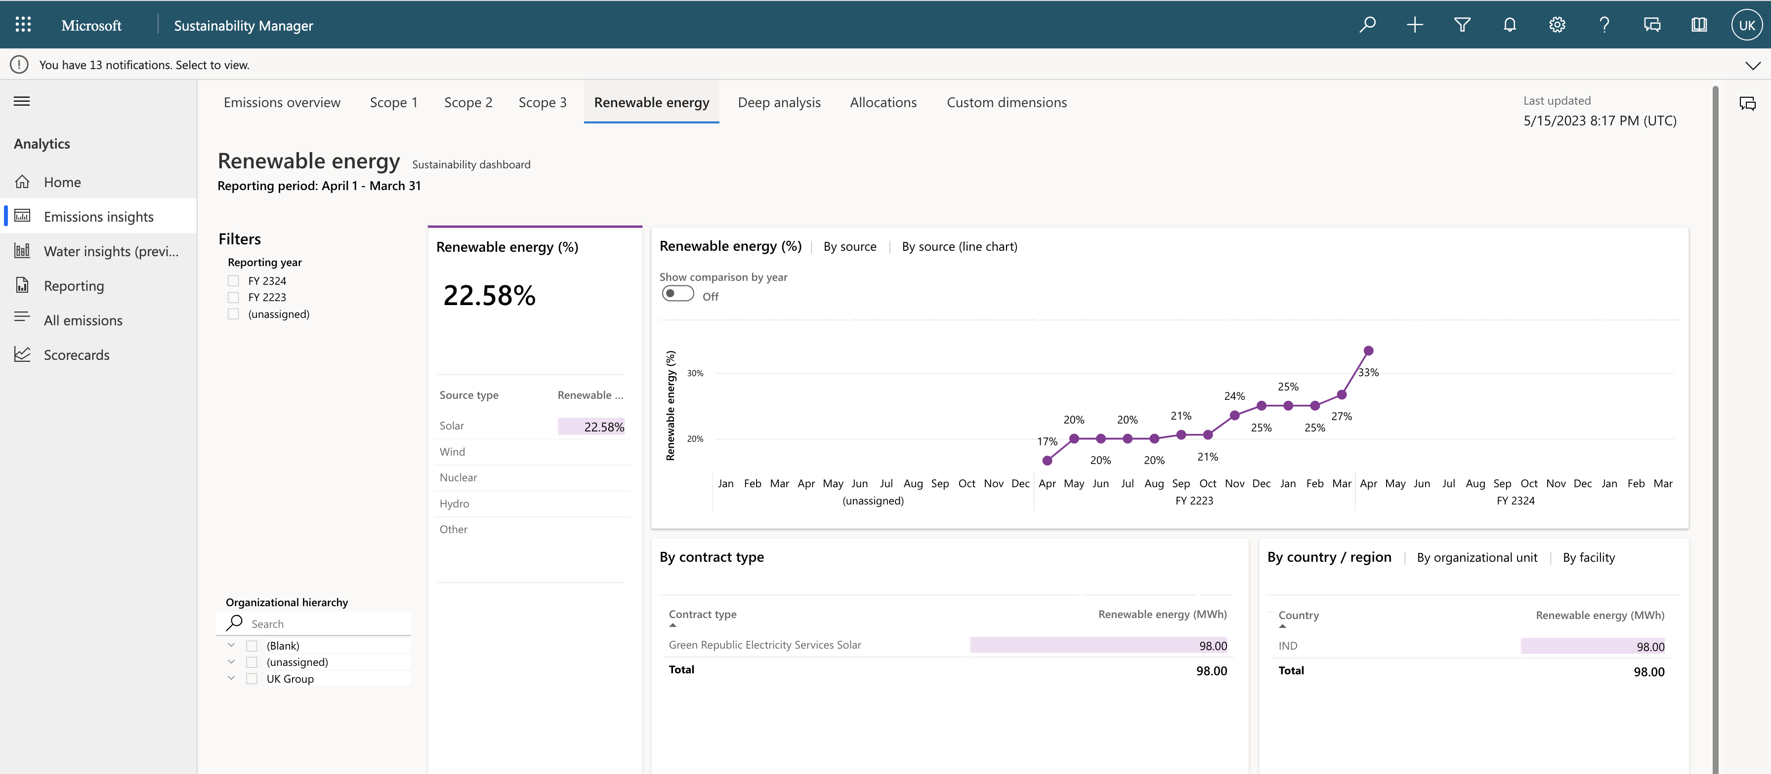
Prototype Implementation – Microsoft sustainability manager
Configure & provide data
Visualize
Define

Slide 8
GitHub Repository Link & supporting diagrams, screenshots, if any
Github link - https://github.com/ukotdiya02/SustainabilityHackathon

Slide 9
Thank You
Uttam Kotdiya
Bhumika Kotdiya

